Slide 1

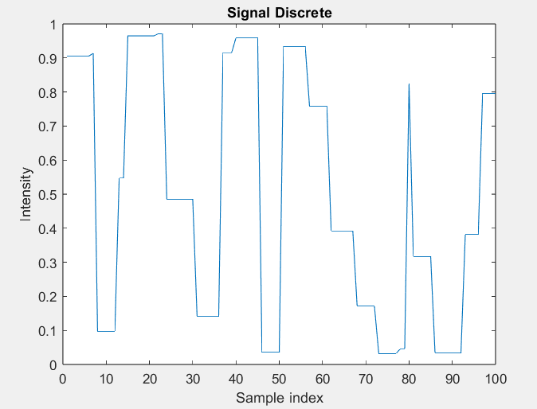
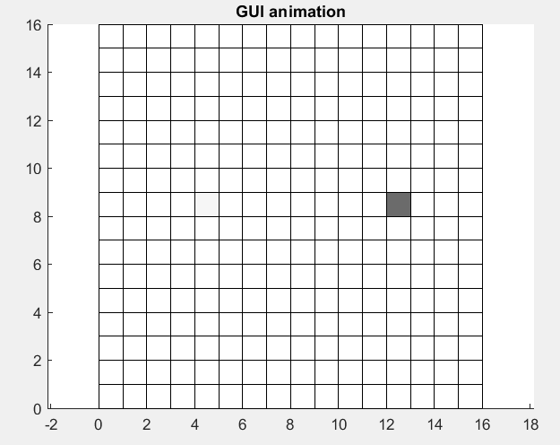
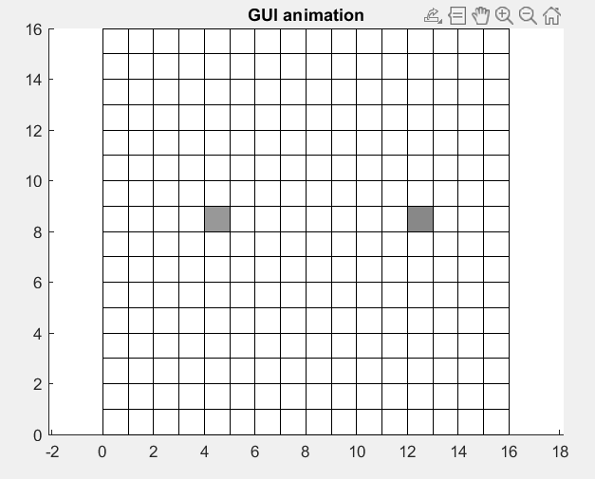
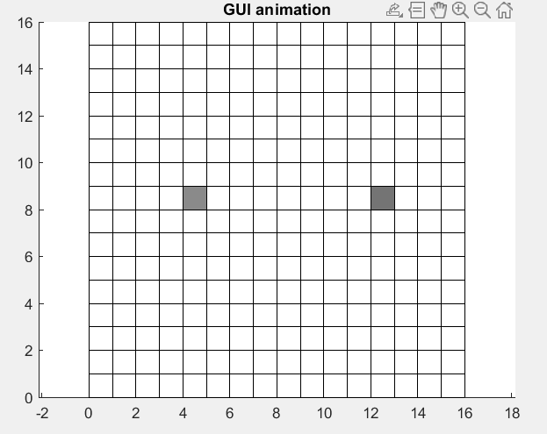
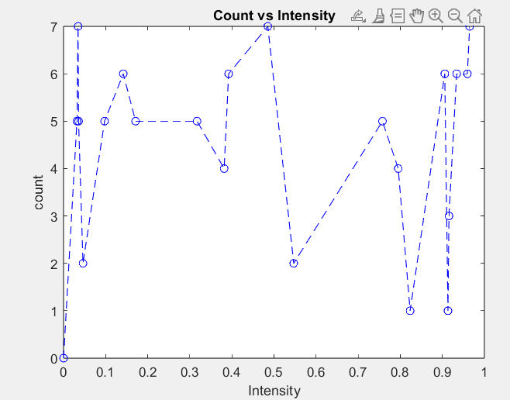



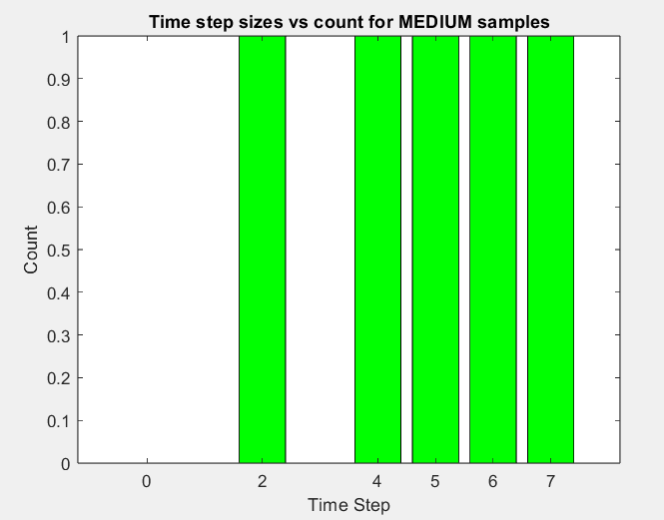
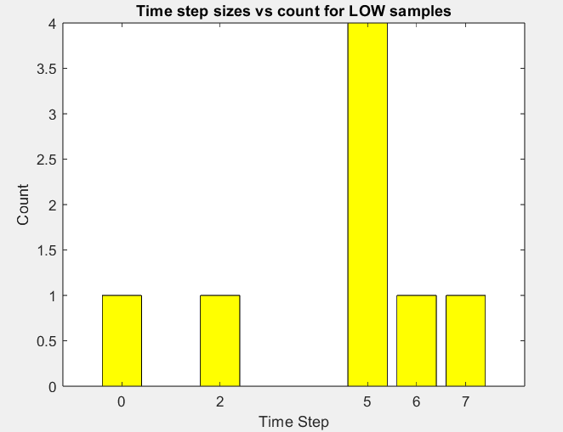
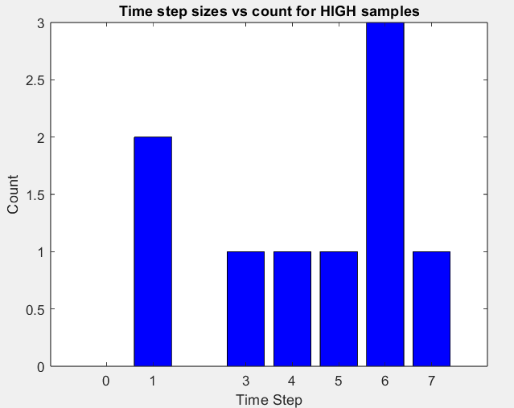
Analysis Program for Blinking Statistics of Quantum Dots in Matlab
Aditya Prasad, Department of Mechanical Engineering
Professor Saumyakanti Khatua, Department of Chemical Engineering
Indian Institute of Technology Gandhinagar, Gujrat
Abstract and Introduction
Work Done till now
Quantum Dots are semi-conductor nanoscale crystals which exhibit quantum properties. By tuning their size we can control the wavelength of the monochromatic emitted light. Hence studying their blinking statistics is vital towards improving their blinking performance.
Created a discrete randomized signal of 100 samples
4. GUI Animation video showing blinking of two Quantum dots
2. Count vs Intensity plot of simulated signal
Objectives
3. Count vs time-step size of different signal types(High, Low, Medium)
Step finding algorithm to find blinking time-step durations of blinking states
Develop a FFT Algorithm and a noise- filtering Algorithm
Power-spectral density(PSD) analysis
Acknowledgment
I would like to express my sincere gratitude to Professor Saumyakanti and NVS Praneeth sir for their invaluable help and guidance with extreme patience and care.

